Slide 1
Events Insights Extraction from Twitter Using LDA and Day-Hashtag Pooling
Muhammad Haseeb UR Rehman Khan
Kei Wakabayashi, Satoshi Fukuyama
University of Tsukuba, Japan

Slide 2
Motivation
Huge datasets of tweets available from millions of users
Users try to sum up an event, trend or their emotions in 140 characters
So, extracting information in time series manner could be very handy to know about real-life events
Sentiment Analysis [12]
Application Area
Real-time events Detection [11]
Comparison with Traditional Media [13]
Topic Popularity Variation [3]
Public Health Opinion Analysis [6]
Notes:
The application area is vast including:
Sentiment prediction analysis [12]
Real-time events detection [11]
Twitter comparison with traditional media [13]
Time series topic popularity variation [3]
Understanding public health opinions [6]

Slide 3
Objective
Information extraction about real-life events using twitter data
Three main keywords:
Events insights
LDA (Latent Dirichlet Allocation)
Day hashtag pooling
Notes:
Title of this research clarify the objective which is

Slide 4
Events Insights
Already many researches have been conducted in same field with similar type of questions, example (Time series and bursty topic detection) [7]
But, mostly used a subset of Twitter data (Selected keywords twitter queries)
[7] used DTM that is not scaled to high number of topics
We used completely raw data having no prior information
Not just focus on events or news but also tried to find some insights
Related information about real-life events like reasons, happening, after effects etc.
Notes:
The limitation of DTM and using subset of twitter rather than full dataset make them unable to extract all the information about real-life events

Slide 5
Topic Modeling
Two widely used models for NLP topic creation problems
DTM (Dynamic topic modeling) [1] Cited more than 2,000 times
LDA (Latent Dirichlet Allocation) [2] Citied around 30,000 times
LDA was used for this research because:
Even though DTM allows the distribution of topics to be changed over time
DTM has a drawback in computational cost, which prevents us to increase number of topics to a relatively high value
The change over time information is partially collected by using day-hashtag pooling and making time series graphs
Notes:
[1] paper published in 2006
[2] paper published in 2003

Slide 6
Day Hashtag Pooling
To some extent it’s combination of hashtag-pooling and temporal pooling [9]
Time-hashtag pooling name was appeared [9] but it was almost ignored in past
Means all the tweets with one hashtag on a specific date are grouped together to make one document
It plays a very important role in the inference part of this research
Notes:
[9] which was introduced by Rishabh in 2010

Slide 7
Proposed Method (Training)
Goal of this research is to develop a technique in such a way that topic trends in tweets data can be analyzed graphically
Data cleaning as much as possible in pre-processing
Used hashtag pooling to make documents relatively bigger
Apply LDA on hashtag pooled documents to train our model

Slide 8
Proposed Method (Inference)
Apply day-hashtag pooling to make an inference dataset
Day-hashtag pooling help us to construct time series graphs
Inference is estimating the number of tweets for each topic in each document
Extract top words for each topic which conveys the meaning of topics and also extract top hashtags used in these topics documents to assist the meaning of topics
Making time series graphs to see topics transition over time visually.

Slide 9
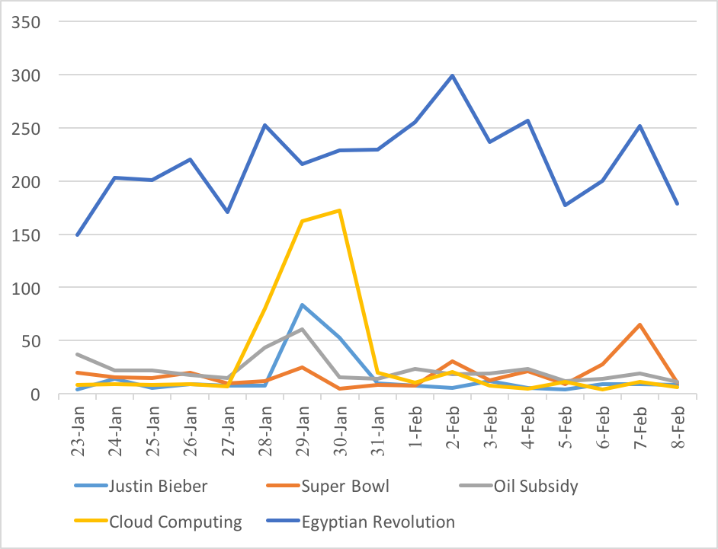
Experiment Flow Diagram
Pre-processing
Tweets2011
English Only
Hashtag Pooled
Tweet 1 (English)
Tweet 2 (Other Lang)
Tweet 3 (English)
Tweet 4 (English)
. .
. .
Tweet 1 (English)
Tweet 3 (English)
Tweet 4 (English)
Tweet 6 (English)
. .
. .
Doc1 (Many tweets)
Doc 2 (Many Tweets)
Doc 3 (Many Tweets)
Doc 4 (Many Tweet)
. .
. .
LDA
Training
Day-hashtag pooled
Got θ_{dk}
and made Time series graphs
Inference
Doc1 (Many tweets)
Doc 2 (Many Tweets)
Doc 3 (Many Tweets)
. .

Slide 10
Dataset
Dataset used: Tweets2011¹
Time period: January 23rd to February 8th 2011
This raw dataset contains tweets in many languages
Extracted English tweets only using langdetect²
More than 3 millions English tweets
Total 275,836 hashtag pooled documents were used as training dataset

Slide 11
Pre Processing
Usually tweets data is very messy So we removed:
Stop words (the, a, an, etc)³
Special characters ($, @, %, etc)
URLS ( http://example.com/ )
Words having only two characters (us, io, ha, etc)
Notes:
Usually tweets data is very messy so some preprocessing was desirable
Because mostly two character words do not have concrete meaning.

Slide 12
LDA Params
LDA with following parameters:
Number of topics: 1000
Number of batch size: 1000
Number of iterations: 1000
Training time: 01:17:54, Inference time(finding θ_{dk} ): 00:16:20
Notes:
Theta dk is probability distributions of topics.

Slide 13
Results
Divided intro three parts
Time series graph analysis
Topics and top words
Topics and top hashtags

Slide 14
Time Series Topic Analysis
Figure 2: Topics transition over time
Burst detection for topics and also peak e.g. “Cloud Computing” and “Super Bowl”
Overall Popular topic detection e.g. “Egyptian Revolution”
Estimated number of tweets

Slide 15
Time Series Topic Analysis (1)
 | Top Words | Top hashtags | Sample Relevant Tweet | Topic Statement
1 | wacky, guitar, soca, ensemble, orgy | #nmlbelieber-1/29, #nmlbelieber-1/30, #muchmusic-1/29, #nml-1/29, n#ml-1/30 | Justin Bieber on NewMusicLive this Tuesday has made me a NMLBELIEBER | Justin Bieber performed on New Music Live
2 | ugh, alcoholic, failure, cans, woke | #superbowl-2/6, #superbowl-2/7, #steelers-2/7, #steelers-2/6, #sb45-2/7 | There are many Super Bowl Parties this Sunday around the Plymouth area at the bars and restaurants. | Super bowl parties
3 | oil, obama, cnn, funding, response | #cars-2/3, #cars-2/7, #us-2/1, #whatif-1/27, #us-1/29 | NYTimes: Obama’s Bid to End Oil Subsidies Revives Debate | Oil price subsidy statement by obama
4 | computing, could- computingexpo, billion, infrastructure, inc | #cloud-1/28, #news-2/3, #cloud-1/29, #cloud-2/2, #services-2/2 | Data Center Links: PEER 1, Telx, IBM, Unisys: IBM Launches $42 Million Cloud Computing Cente... | Cloud Computing service launch by IBM
5 | news, video, facebook, live, blog | #egypt-1/31, #jan25-2/2, #jan25- 2/1, #egypt-1/29, #egypt-2/1 | "Internet is a gift from God for all of ""Egyptians"". They shut it down and We were just ""Gyptians" | Social Media played an important role in Egyptian revolution

Slide 16
Topics and Top Words
 | Topic | Top words
1 | Music | song, listening, club, track, right, ra- dio, home, hot, high, ill
2 | Education | learning, education, past, language, driven, brush, lessons, intelligent, digg, arts
3 | USA | american, gov, spread, brotherhood, reform, barackobama, decades, democracy, 500, damon
4 | Climate | moon, fine, weather, baro, rising, speed, officialkimora, waning, sun- rises, mostly
5 | Gadgets | gps, laptop, battery, watch, charger, nike, wifi, tablet, color, high
6 | Football | deal, suarez, club, carroll, kenny, player, transfer, players, request, luis
7 | Justin Bieber | newmusiclive, justin, bieber, made, tuesday, say, pattie, beiber, till, be- lieber
8 | Photography | photos, m4w, gallery, photographer, camera, w4m, stunning, fleur, pho- tographic, kitty
9 | Gaming | xbox, trailer, ops, 360, famous, beta, protests, capcom, unlocked, brief
10 | Violence | kills, dead, weekly, iron, headshots, transforming, architects, slayer, tix, attack
Table 1: Top words of topics
Notes:
In this slide, all the topics looks very promising, because from the top words we can easily come up with a topic title

Slide 17
Topics and Top Hashtags
 | Topic | Top hashtags –month/date
1 | Music | #nowplaying-2/3, #nowplaying- 2/8, #np-1/27, #nowplaying-1/27, #nowplaying-2/2
2 | Education | #8days-2/3, #bring5friends-1/23, #happybirthdayharry-2/1, #twitition-1/27, #welovestyles-1/23
3 | USA | #egypt’s-2/5, #egypt-1/28, #scariestwordsever-2/5, #jan25-1/29, #sfo-2/6
4 | Climate | #news-1/32, #nowwatching-2/4, #aquarius-2/2, #zodiacfacts-2/1, #unknownwhat-1/26
5 | Gadgets | #twalue-1/25, #lfc-1/30, #americanidol-1/27, #teamfollowback-2/8, #worstpickuplines-2/2
6 | Football | #gwo-1/29, #mbteamcl-2/2, #global-2/7, #nufc-1/31, #aquarius-1/26
7 | Justin Bieber | #nmlbelieber-1/28, #hosting-2/4, #hosting-1/29, #muchmusic-1/31, #hosting-2/5
8 | Photography | #news-1/23, #thegame-2/2, #np-2/2, #fail-2/7, #neversaynever3d-1/24
9 | Gaming | #twibbon-1/24, #twibbon-2/7, #magistream-2/5, #blackandyellow-2/7, #thegame-2/2
10 | Violence | #jan25-2/2, #egypt-2/3, #jan25-2/1, #jan25-2/4, #jan25-2/3
Table 2: Top hashtags of topics
Notes:
But when we compare it with top hashtags extracted for these same topics. Then we can see some topic’s top hashtag doesn’t match their topic title for exp [2,8,5] which means maybe these topics are not conveying the correct information.

Slide 18
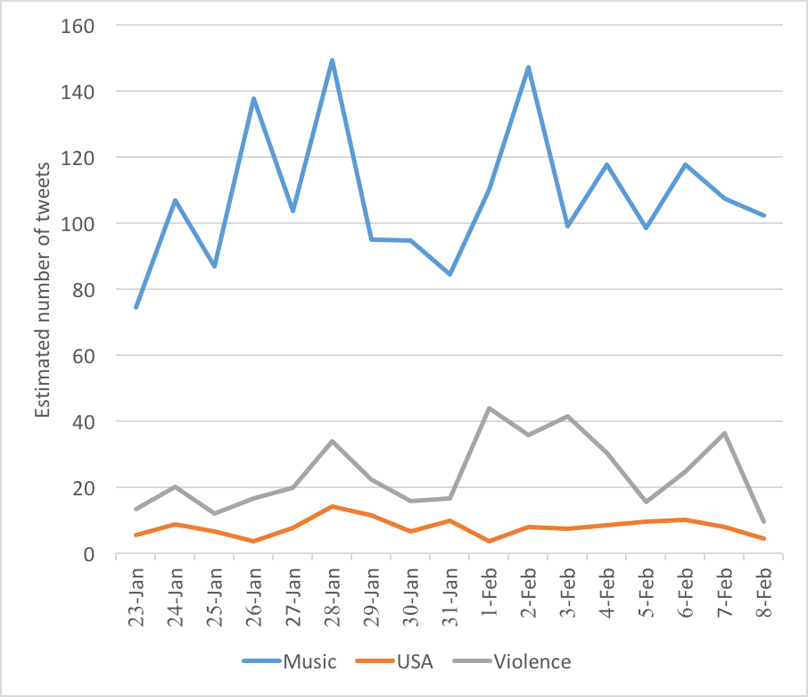
Population Graph
From Table 1 and Table 2:
Topic Music, USA and Violence are shown here in time series graph
Notes:
When we further analyze these topics in population graph then we can see, even though some topics have matching top words and matching top hashtags but estimated number of tweets for these topics are very low which means they were not very much popular topics. In above case people were much more interest in topic music as compared to topic USA.

Slide 19
Conclusion
Used original machinery of LDA along with hashtag pooling
Showed the advantage of day hashtag pooling
Proposed a method which can extract time series topics trends using LDA trained on high number of topics which DTM can’t do because of high computational cost
Not only can detect bursty topics but also can extract the level and interval of burstiness

Slide 20
References
[1] David M Blei and John D Lafferty. 2006. Dynamic topic models. In Proceedings of the 23rd international conference on Machine learning. ACM, 113–120.
[2] David M Blei, Andrew Y Ng, and Michael I Jordan. 2003. Latent Dirichlet Allocation. Journal of Machine Learning Research 3 (2003), 993–1022.
[3] Satoshi Fukuyama and Kei Wakabayashi. 2018. Extracting time series variation of topic popularity in microblogs. In Proceedings of the 20th International Conference on Information Integration and Web-based Applications & Services. ACM, 365–369.
[6] Amir Karami, Alicia A Dahl, Gabrielle Turner-McGrievy, Hadi Kharrazi, and George Shaw Jr. 2018. Characterizing diabetes, diet, exercise, and obesity comments on Twitter. International Journal of Information Management 38, 1 (2018), 1–6.
[7] Daichi Koike, Yusuke Takahashi, Takehito Utsuro, Masaharu Yoshioka, and Noriko Kando. 2013. Time series topic modeling and bursty topic detection of correlated news and twitter. In Proceedings of the Sixth International Joint Conference on Natural Language Processing. 917– 921.
[9] Rishabh Mehrotra, Scott Sanner, Wray Buntine, and Lexing Xie. 2013. Improving lda topic models for microblogs via tweet pooling and automatic labeling. In Proceedings of the 36th international ACM SIGIR conference on Research and development in information retrieval. ACM, 889–892.
[11] Takeshi Sakaki, Makoto Okazaki, and Yutaka Matsuo. 2010. Earthquake shakes Twitter users: real-time event detection by social sensors. In Proceedings of the 19th international conference on World wide web. ACM, 851–860.
[12] Andranik Tumasjan, Timm O Sprenger, Philipp G Sandner, and Is- abell M Welpe. 2010. Predicting elections with twitter: What 140 characters reveal about political sentiment. In Fourth international AAAI conference on weblogs and social media.
[13] Wayne Xin Zhao, Jing Jiang, Jianshu Weng, Jing He, Ee-Peng Lim, Hongfei Yan, and Xiaoming Li. 2011. Comparing twitter and tradi- tional media using topic models. In European conference on information retrieval. Springer, 338–349.

Slide 21
Thank You! Any Questions

